Slide 1
INTRODUCTION TO TAXONOMY Dr Heather Campbell

Slide 2

TAXONOMY
Classification
deciding what groups to have
Nomenclature naming the groups

Slide 3
CLASSIFICATION
Find as many ways as possible to classify the blocks
Make a list to keep track of the classification system and which specimens belong in which group

Slide 4
CLASSIFICATION
CLASSIFY BY SHAPE:
Squares = specimens A, B, C
Triangles = specimens D, E, F
CLASSIFY BY COLOUR:
Blue = specimens A, D
Yellow = specimens B, E
Orange = specimens C, F
A
B
C
A
D
B
E
D
E
F
C
F

Slide 5


Slide 6
HIERARCHY

Slide 7
HIERARCHY The organisation of a hierarchy is based on knowledge/experience
Which one belongs to the gardener?

Slide 8
HIERARCHY
Using the blocks create a hierarchy based on some of the previous characteristics you used for classification

Slide 9
HIERARCHY
SHAPES
SQUARES
TRIANGLES
BLUE
YELLOW
ORANGE
BLUE
YELLOW
ORANGE

Slide 10
Classifications and hierarchies are based on scientifically available knowledge and personal experience
Is taxonomy a science?
What defines a unique taxonomic unit (a species/genus/family etc)?
Are you a lumper or a splitter?
What additional information do you need to make a decision?
Knowledge changes over time

Slide 11
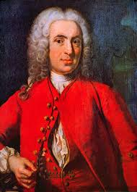

Slide 12
Carl Linnaeus
“join the similar to the similar, and to separate the dissimilar from the dissimilar in nature.”

Slide 13
Carl Linnaeus
Linnaeus’ system of classification used seven major groups:
Empire
Kingdom
Class
Order
Genus
Species
Variety

Slide 14
Linnaeus’ system of classification used seven major groups:
Empire
Kingdom
Class
Order
Genus
Species
Variety
Phylum
Family
Carl Linnaeus
Not widely used. More common in botany.

Slide 15
Modern system of classification
Kingdom*
Phylum
Class
Order
Family
Genus
Species
Carl Linnaeus
*some dispute about higher level taxonomy

Slide 16
Modern system of classification
Group | Taxonomic name
Kingdom | Animalia
Phylum | Arthropoda
Class | Insecta
Order | -tera
Superfamily | - oidea
Family | -idae
Genus
Species | binomial

Slide 17
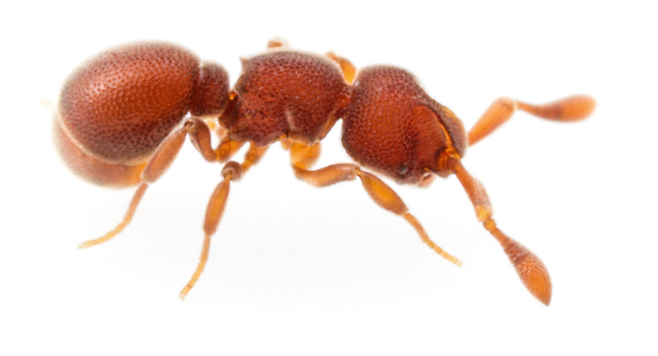
Modern system of classification
Discothyrea mixta Brown, 1958

Slide 18
TAXONOMY
Classification
deciding what groups to have
Nomenclature naming the groups

Slide 19
DESCRIBING A SPECIES

Slide 20
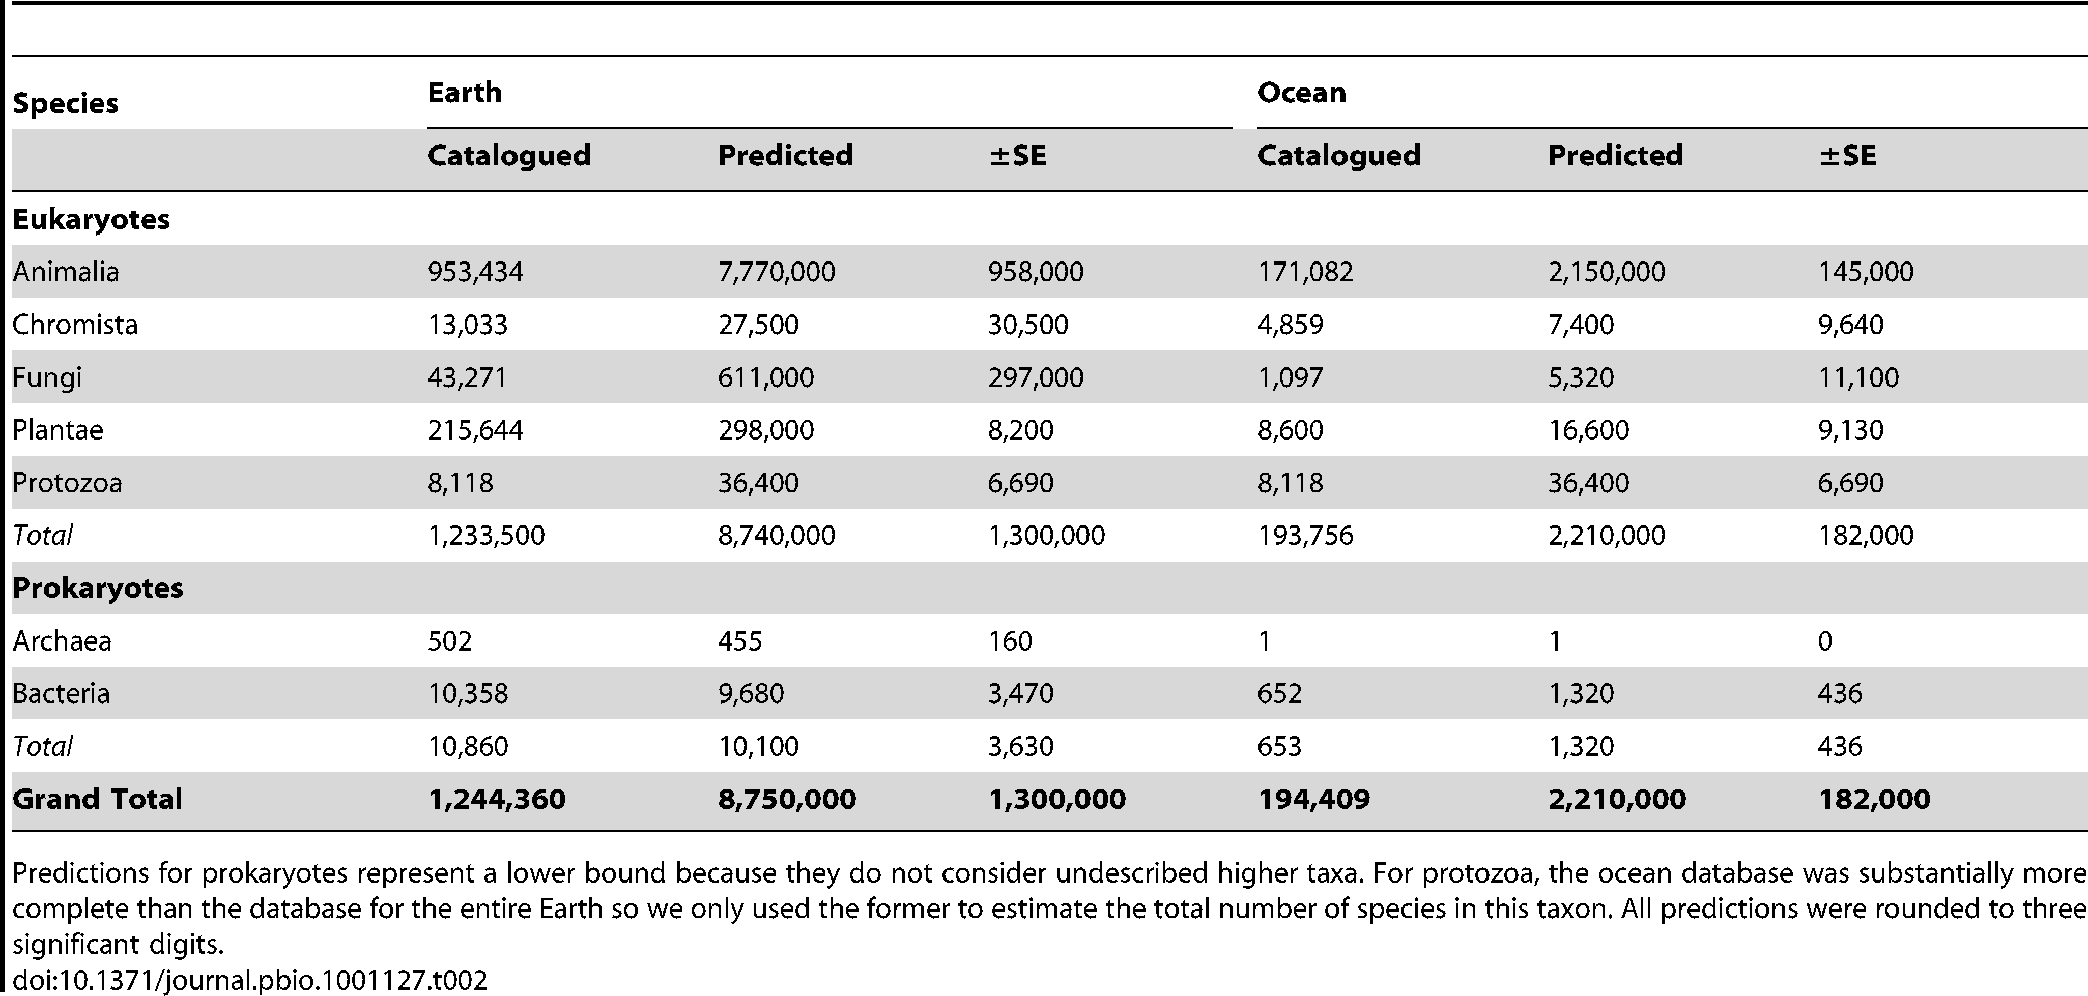
How do you describe a new species?
Step 1: Find something you think is new.

Slide 21
How do you describe a new species?
Step 1: Find something you think is new.
“In spite of 250 years of taxonomic classification and over 1.2 million species already catalogued in a central database, our results suggest that some 86% of existing species on Earth and 91% of species in the ocean still await description.”
Mora et. al. (2011) PLOS Biology

Slide 22
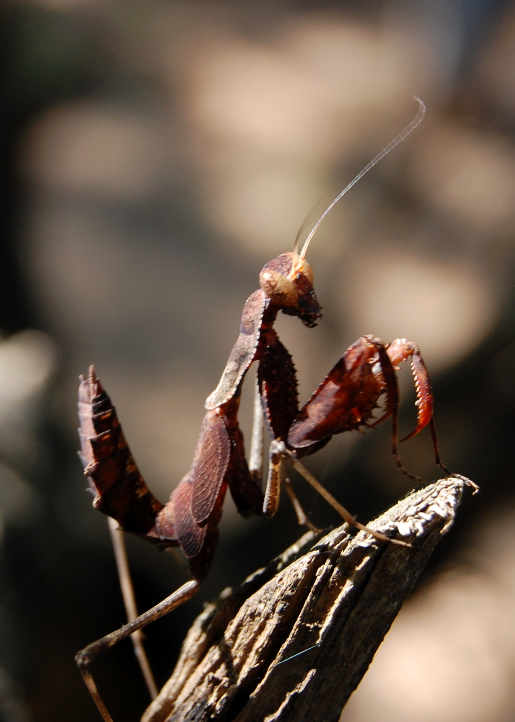
How do you describe a new species?
Step 2: Identify your specimen.
You need to show that the specimen you have is part of a particular higher taxon (usually the genus)

Slide 23
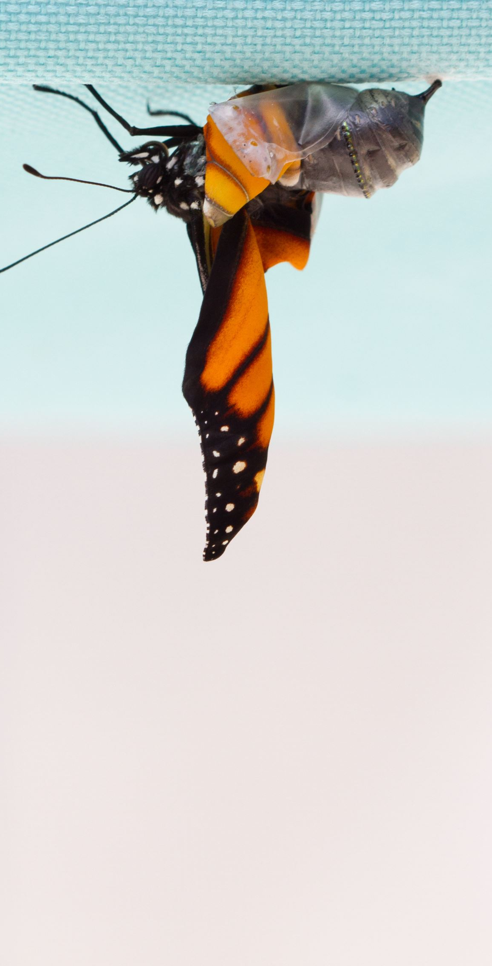
How do you describe a new species?
Step 3: Differential diagnosis.
You have convinced yourself and — more importantly — everyone else that your species is correctly designated to a higher taxon. Now you have to prove that your species is different than all of the other species in that taxon.

Slide 24
How do you describe a new species?
Steps 2 & 3
Use of keys for identification
Comparison of your specimens with museum collection material, especially type material, with a determination based on
external morphology
dissection of genitalia
DNA sequences
location
behavior

Slide 25
How do you describe a new species?
Step 4: Describe it. Hooray, you have a new species!
Now you need to write a species description.
This should ideally include lots of written morphological descriptions, measurements, photos, illustrations, and genetic sequences/barcodes.
It is often necessary to review the taxonomy of closely related species and provide a descriptive comparison or species key.

Slide 26

Discothyrea mixta Brown, 1958
Taxonomic History
Discothyrea mixta Brown, 1958g: 343, figs. 47, 48 (w.) LIBERIA. Afrotropic. Primary type information: Type-material: holotype worker. Type-locality: Liberia: Bolahun (J.C. Bequaert). Type-depository: MCZC. Type-specimen: MCZ_Holotype_29872. Secondary type information: Paratype-material: 4 paratype workers. Paratype-locality: same as for holotype. Paratype-depositories and specimens: MCZC: MCZ_ Paratype_29872; MHNG: CASENT0911150; USNM. Type notes: Brown, 1958g: 344, records that 1 paratype was destroyed during dissection.
Taxonomic history
Status as species: Leston, 1971: 117; Bolton, 1995b: 171; Hita Garcia et al., 2013: 222; Hita-Garcia & Lieberman, 2019: 18 (redescription).

Slide 27
How do you describe a new species?
Step 5: Get ready to publish it.
This means that your specimens have been properly curated, your description is up to snuff, and your species has a name.
What do you name it? That’s up to you and the fabled ICZN rules!!!

Slide 28
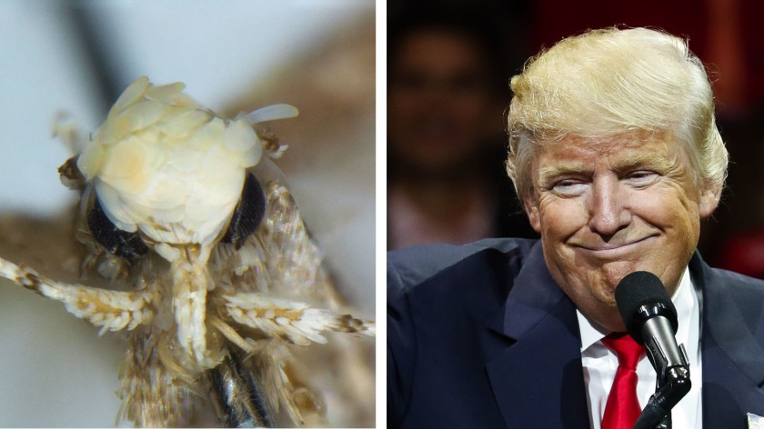

How do you describe a new species?
Step 6: Publish your description

Slide 29
How do you describe a new species?
Step 6: Publish your description

Slide 30
The taxonomic impediment
Karl Kjer says, “The major impediment to species discovery is the lack of trained taxonomists, and the shameful lack of support for their work.”

Slide 31
The taxonomic impediment
Taxonomy is time-consuming, under-funded and not well-rewarded in a career/academic sense (grants, publications etc.)
Citation of taxonomic publications: the why, when, what and what not
RUDOLF MEIER
21 October 2016

Slide 32
Journal Impact Factors
Nature = 43.070
TREE = 15.236
Ecology Letters = 8.699
Annual Review of Entomology = 11.796
Insect Biochemistry and Molecular Biology = 3.618
Insect Conservation and Diversity = 2.313
ZooKeys = 1.143
Zootaxa = 0.990

Slide 33


Naming a species
Taxonomists must ensure that a species has only one name;
Synonyms = Multiple names for one taxon
Homonyms = The same name for multiple taxa
This is accomplished through principles in the ICZN code
Synonyms
Homonyms
Carabus harperi
Carabus newportus
Carabus newportus
Carabus newportus

Slide 34
Nomenclature Codes
International Code of Nomenclature for algae, fungi, and plants (ICN). This replaced the International Code of Botanical Nomenclature (ICBN)
International Code of Zoological Nomenclature (ICZN)
Bacteria and Archaea – International Code of Nomenclature of Prokaryotes (ICNP). This replaced the International Code of Nomenclature of Bacteria (ICNB)
The International Code of Virus Classification and Nomenclature (ICVCN)
International Code of Nomenclature for Cultivated Plants (ICNCP)

Slide 35
Who are the ICZN?
The International Commission on Zoological Nomenclature (ICZN) acts as adviser and arbiter for the zoological community by generating and disseminating information on the correct use of the scientific names of animals.
The ICZN is responsible for producing the International Code of Zoological Nomenclature - a set of rules for the naming of animals and the resolution of nomenclatural problems.

Slide 36
Naming a species
Principle of binominal nomenclature
A species name will always be composed of two parts;
generic name
species name
Subspecies can have a three-part name, higher taxa have a single name

Slide 37
Naming a species
Principle of priority
The correct, oldest available name given to a taxon is the name that will be used. This is called the valid name.
Once a name has been used, no subsequent publication of that name for another taxon shall be valid. The exception to this is across kingdoms.

Slide 38
Naming a species
Principle of coordination
The principle of coordination is that within the family group, genus group and species group, a name established for a taxon at any rank in the group is simultaneously established with the same author and date for taxa based on the same name-bearing type at other ranks in the corresponding group.

Slide 39
Naming a species
Principle of the first reviser
The principle of the first reviser deals with situations that cannot be resolved by priority.
These items may be two or more different names for the same taxon, two or more names with the same spelling used for different taxa, two or more different spellings of a particular name, etc.

Slide 40

Naming a species
Principle of homonymy
Each taxon name must be unique.
A name that is a junior homonym of another name is not a valid name.
Secondary homonyms can be produced if taxa with the same specific name but different original genus are later classified in the same genus.
Guidelines for the capture and management of digital zoological names information – 2012 GBIF
Carabus newportus
Carabus newportus
Coccinella newportus

Slide 41
Naming a species – homonyms
Scopoli (1763) established Curculio fasciatus (Coleoptera) for a species from Slovenia.
Strøm (1768) established Curculio fasciatus for another species from Norway.
De Geer (1775) established Curculio fasciatus for a 3rd species from Sweden.
Müller (1776) established Curculio fasciatus for a 4th species from Denmark.
Fourcroy (1785) established Curculio fasciatus for a 5th species from France.
Olivier (1790) established Curculio fasciatus for a 6th species from France.
Marsham (1802) established Curculio fasciatus for a 7th species from Britain.
These are all different species!!!!

Slide 42
Hemihomonyms
an animal taxon and plant taxon have the same name
Animal | Plant/Fungus
Agathis montana Shestakov (a wasp) | Agathis montana de Laub. (the Mount Panié kauri, a conifer)
Asterina gibbosa Pennant (the starlet cushion star, a starfish) | Asterina gibbosa Gaillard (a fungus)
Baileya australis Grote (the small baileya moth) | Baileya australis Rydb. syn. B. multiradiata (a desert marigold)
Centropogon australis White (the fortescue, a waspfish) | Centropogon australis Gleason (a bellflower)
Orestias elegans Garman (a pupfish) | Orestias elegans Ridl. (an orchid)
Tritonia pallida Stimpson (a nudibranch) | Tritonia pallida Ker Gawl. (an iris)

Slide 43
Naming a species
Principle of typification
This is the principle that each nominal taxon in the family group, genus group, or species group has—actually or potentially—a name-bearing type fixed that provides the objective standard of reference that determines what the name applies to.

Slide 44
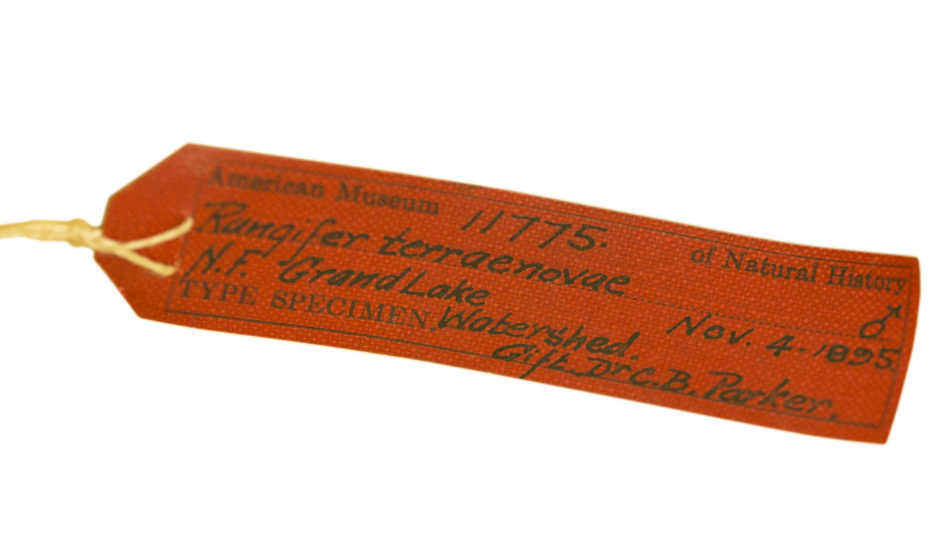
What is a type specimen?
Historically speaking, species are described by taxonomists and this description consists of observations made on a Type specimen. The Type specimen is representative of a species but need not be 'typical' in appearance. The Type specimen acts as the 'name bearer' for that species.
By comparing other specimens with the Type specimen (or the description of the Type specimen) it can be determined if these other specimens belong to the same species.

Slide 45
Types of types
Holotype - a single specimen that is the name bearer of the species.
Syntype - when a species is first described the author may choose several specimens as being representative of the species rather than pick a single holotype. Each specimen is known as a syntype.
Lectotype - a specimen that was selected after the first description of the species to act as a holotype when the original author did not designate a holotype (often from the syntypes).
Paratype - other specimens that are listed as representative when a species is described in addition to a holotype.
Neotype - a specimen selected to act as the holotype for a species after the species was first described and the original holotype was lost or destroyed.
Plesiotype - a specimen on which a later description was based.

Slide 46
Names of names
nomen dubium a name of unknown or doubtful origin. This may happen if the original type series is lost or destroyed, or if a type specimen was not designated.
nomen nudum a name that looks like a binomial but fails to be one because it has not (yet) been published with an adequate description.
nomen oblitum a name that is not used within the scientific community since 1899, and when it is either a senior synonym or a homonym, and when the preferred junior synonym or homonym has been shown to be in wide use in 50 or more publications in the past few decades.
nomen novum a replacement name created when the other name cannot be used for technical, nomenclatural reasons (not for taxonomic/scientific reasons).
nomen conservandum a name otherwise unavailable or invalid that the Commission, by the use of its plenary power, has enabled to be used as a valid name by removal of the known obstacles to such use.
nomen protectum a conserved name that is either a junior synonym or homonym that is in use because the senior synonym or homonym has been made a nomen oblitum.

Slide 47
On the use of whimsical names in taxonomy
McClellan (1982) said ‘I have little doubt that entomologists, out of sheer desperation, must be the most prolific of fanciful namesmiths in biology, hands down. I invite replies from any and all taxonomists who might help me test that hypothesis!’

Slide 48
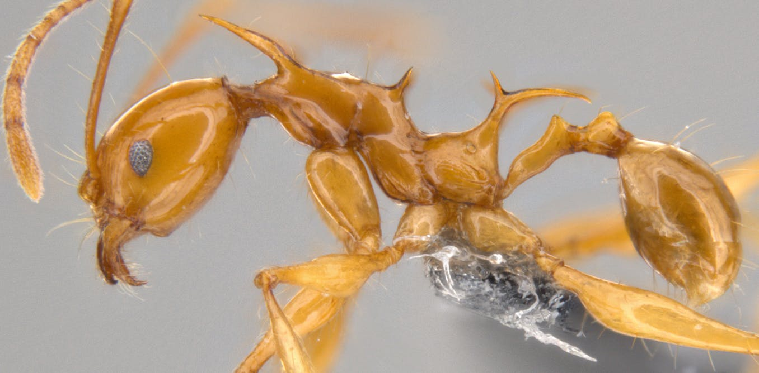
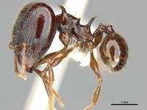
Games of Thrones ants
The jet-black species is called Pheidole drogon after Drogon, the beast of the same colour, and the gold-hued Pheidole viserion is named after the white and gold Viserion.

Slide 49
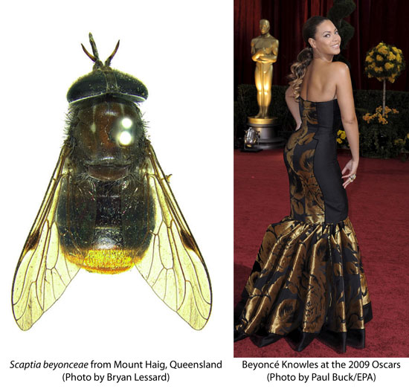
Beyonce fly

Slide 50
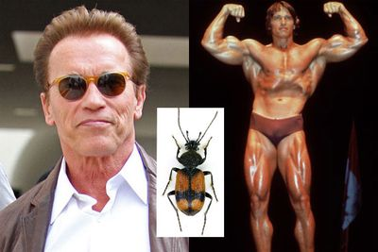
Arnold Schwarzenegger carabid
Agra schwarzeneggeri Erwin, 2002

Slide 51
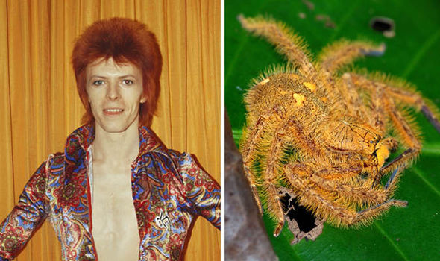
David Bowie spiders
Bowie ziggystardust, Bowie majortom, or Bowie heroes, in reference to the musician's hits or characters. In the northwestern part of the range, the older Bowie songs provided inspiration for the naming; in the central areas, names such as Bowie teenagewildlife or Bowie chinagirl can be found, while in the southeast in New Guinea, Bowie's latest oeuvre is commemorated with Bowie lazarus and Bowie blackstar

Slide 52
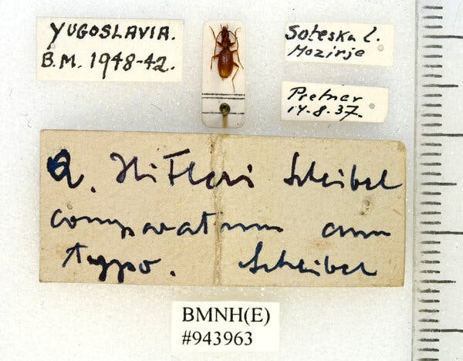
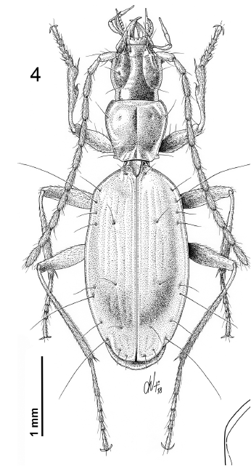
Anophthalmus hitleri
Duvalius owensi after Jesse Owens

Slide 53
RECOMMENDED READING
More information of the ICZN code ICZN website
Berenbaum M (2014) Buzzwords: Not Your Father’s Patronym. American Entomologist 60: 69-70
De Queiroz K (2007) Species concepts and species delimitation. Systematic Biology 56: 879-886.
Mora et al. (2011) How Many Species Are There on Earth and in the Ocean? PLOS Biology 9(8): e1001127
Nazari (2017) Review of Neopalpa Povolný, 1998 with description of a new species from California and Baja California, Mexico (Lepidoptera, Gelechiidae) Zookeys 646: 79-94

